Slide 1
ONLINE NEWS APP
Here is where your presentation begins

Slide 2
CONTENTS OF THIS TEMPLATE
Here’s what you’ll find in this Slidesgo template:
A slide structure based on a pitch deck, which you can easily adapt to your needs. For more info on how to edit the template, please visit Slidesgo School or read our FAQs.
An assortment of graphic resources that are suitable for use in the presentation can be found in the alternative resources slides.
A thanks slide, which you must keep so that proper credits for our design are given.
Several resources slides, where you’ll find links to all the elements used in the template.
Instructions for use.
Final slides with:
The fonts and colors used in the template.
A selection of illustrations. You can also customize and animate them as you wish with the online editor. Visit Storyset to find more.
More infographic resources, whose size and color can be edited.
Sets of customizable icons of the following themes: general, business, avatar, creative process, education, help & support, medical, nature, performing arts, SEO & marketing, and teamwork.
You can delete this slide when you’re done editing the presentation.

Slide 3
01
PROBLEM VS. SOLUTION
02
OUR PRODUCT
TABLE OF CONTENTS
03
MARKET & COMPETITION
04
BUSINESS MODEL
You can describe the topic of the section here
You can describe the topic of the section here
You can describe the topic of the section here
You can describe the topic of the section here

Slide 4
ONLINE NEWS APP
You can give here a brief description of the topic you want to talk about. For example, if you want to talk about Mercury, you can say that it’s the smallest planet in the entire Solar System

Slide 5
OUR COMPANY
Mercury is the closest planet to the Sun and the smallest one in the Solar System—it’s only a bit larger than the Moon. The planet’s name has nothing to do with the liquid metal

Slide 6

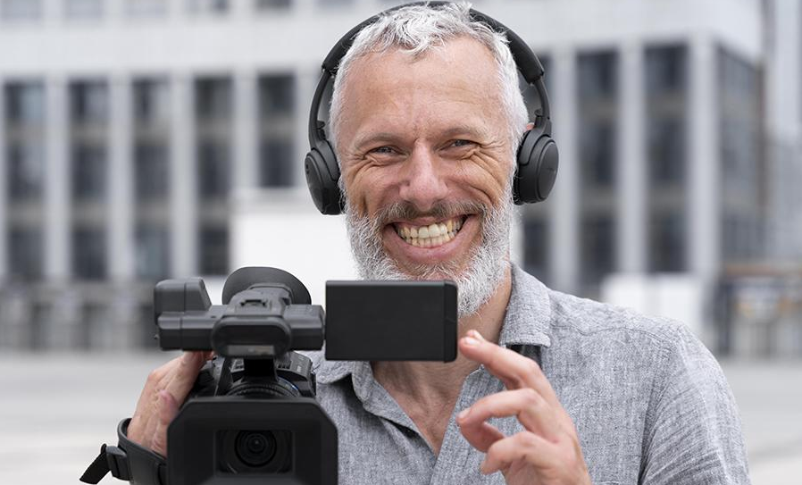
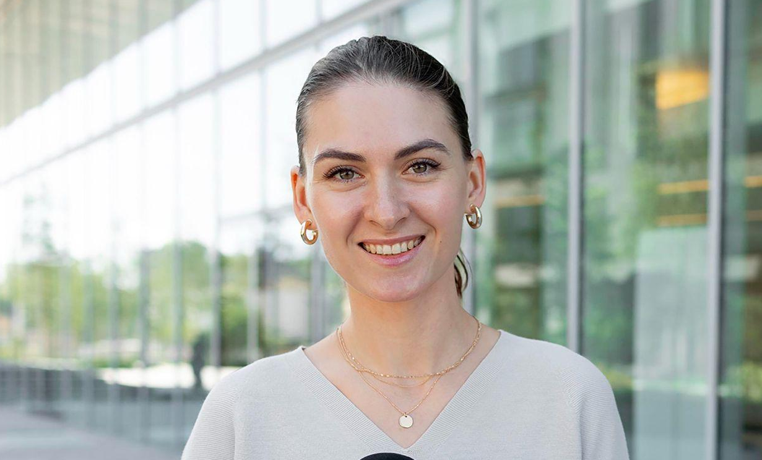
OUR TEAM
JENNA DOE
JOHN BONES
SUE SMITH
You can replace the image on the screen with your own
You can replace the image on the screen with your own
You can replace the image on the screen with your own

Slide 7

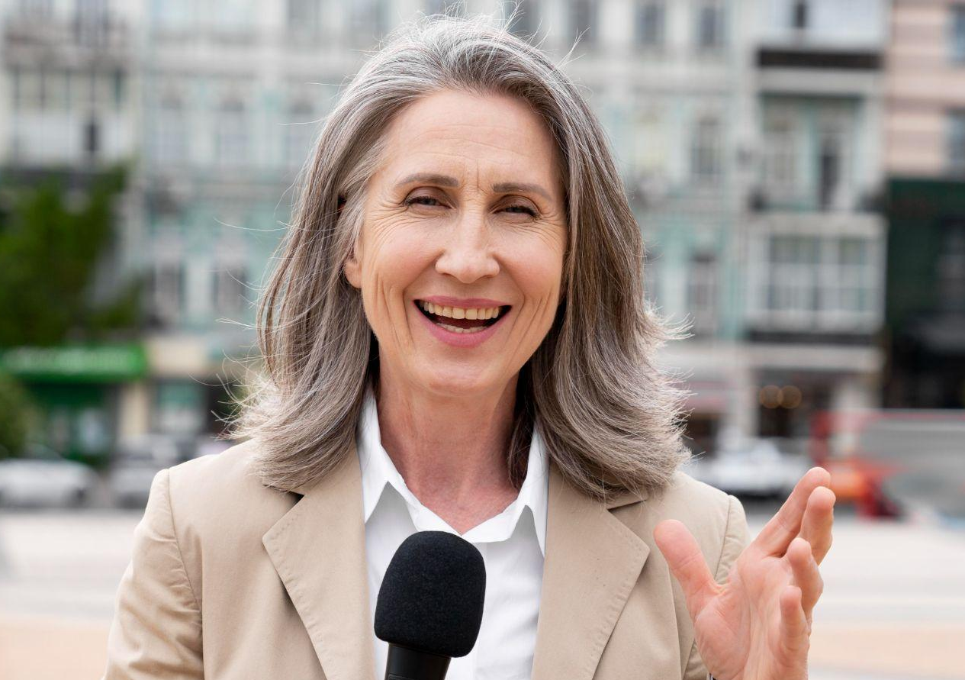
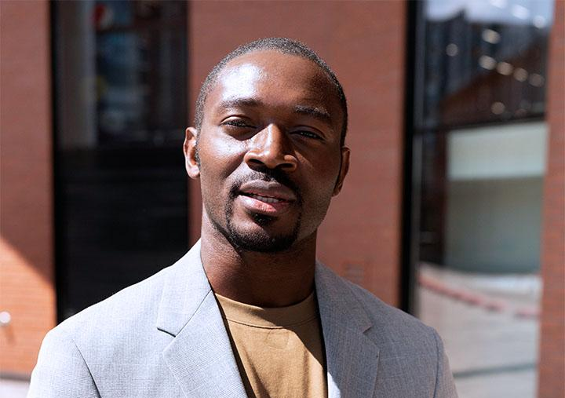
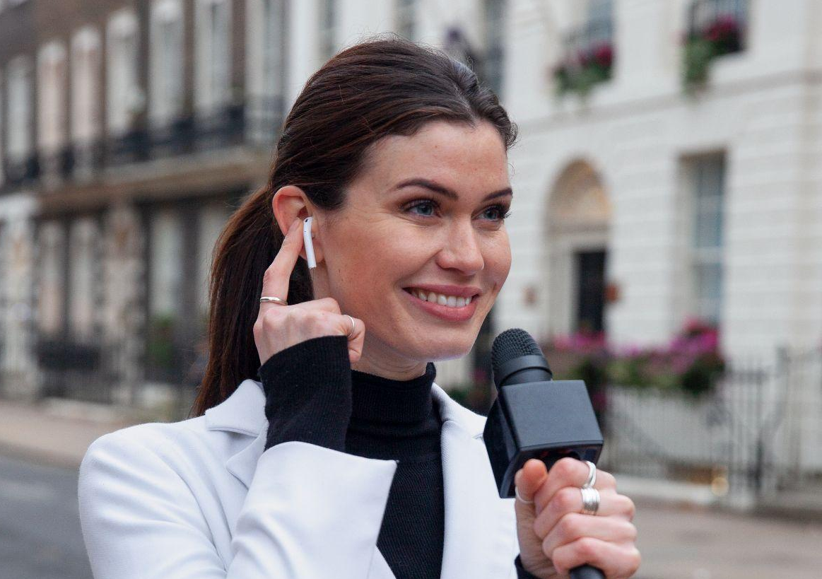
MEET OUR TEAM
JOHN JAMES
JENNA DOE
TIMMY JIMMY
SUSAN BONES
You can speak a bit about this person here
You can speak a bit about this person here
You can speak a bit about this person here
You can speak a bit about this person here

Slide 8
—SOMEONE FAMOUS
“This is a quote, words full of wisdom that someone important said and can make the reader get inspired”

Slide 9
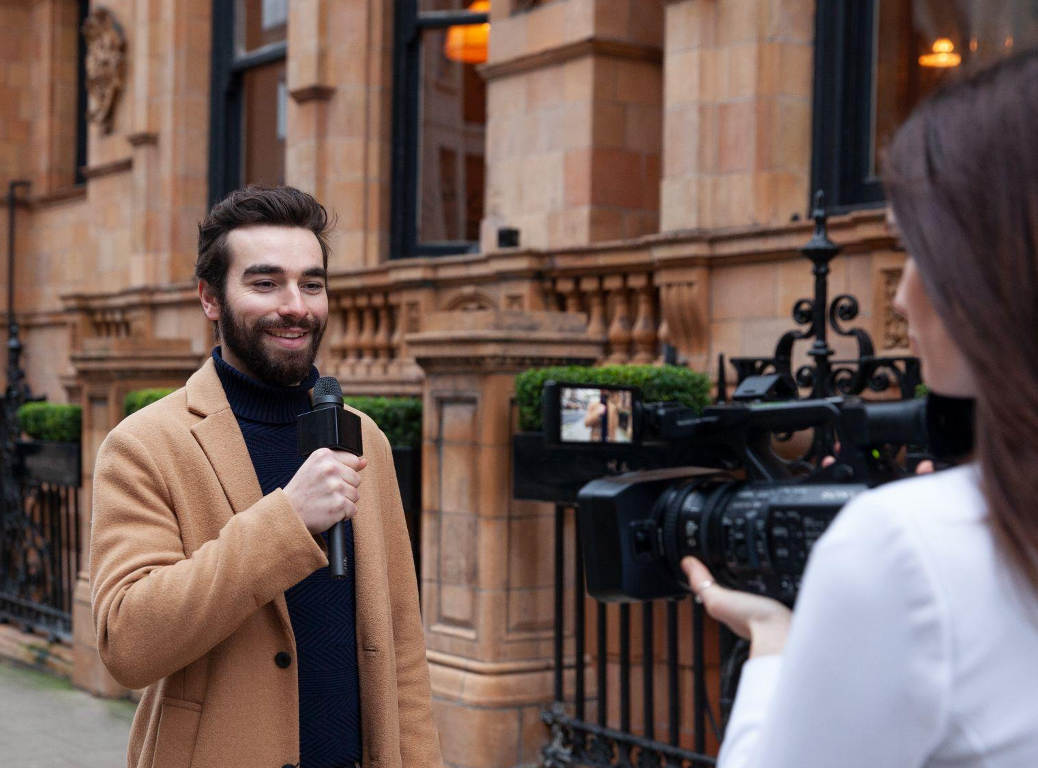
—SOMEONE FAMOUS
“This is a quote, words full of wisdom that someone important said and can make the reader get inspired.”

Slide 10
01
PROBLEM VS. SOLUTION
You can enter a subtitle here if you need it

Slide 11
TWO COLUMNS
MERCURY
Mercury is the closest planet to the Sun and the smallest one in the Solar System—it’s only a bit larger than the Moon
VENUS
Venus has a beautiful name and is the second planet from the Sun. It’s hot and has a poisonous atmosphere

Slide 12
OUR DIFFERENTIAL VALUE
SATURN
VENUS
This is the ringed planet. It’s a gas giant, composed of hydrogen and helium
Venus has a beautiful name and is the second planet from the Sun

Slide 13

A PICTURE IS WORTH A THOUSAND WORDS

Slide 14
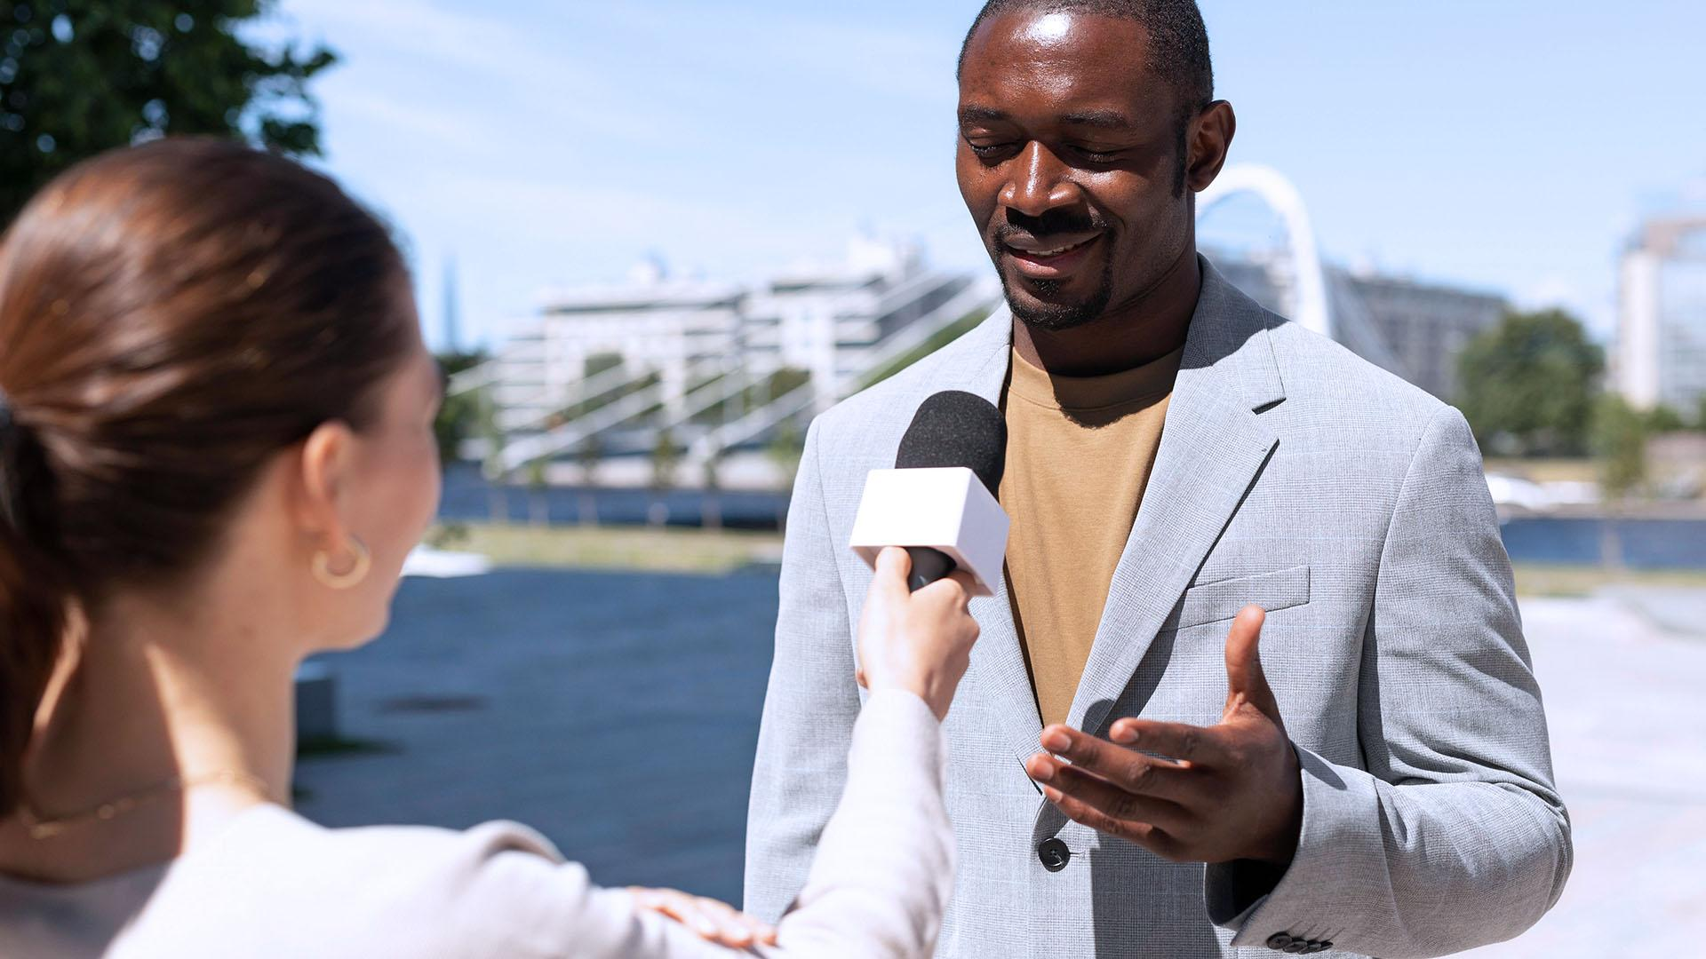
A PICTURE IS WORTH A THOUSAND WORDS

Slide 15
PROBLEM
Mercury is the closest planet to the Sun and the smallest one in the Solar System—it’s only a bit larger than the Moon. The planet’s name has nothing to do with the liquid metal
LOGIN
NEW ACCOUNT

Slide 16
THEM VS. US
THEM
US
Mercury is the closest planet to the Sun and the smallest
Jupiter is the biggest planet in the Solar System

Slide 17
SOLUTION
Jupiter is a gas giant and the biggest planet in the Solar System. It's the fourth-brightest object in the night sky. It was named after the Roman god of the skies and lightning
USERNAME
PASSWORD
LOGIN

Slide 18

A PICTURE ALWAYS REINFORCES THE CONCEPT
Images reveal large amounts of data, so remember: use an image instead of a long text

Slide 19
OUR PRODUCTS
02
You can enter a subtitle here if you need it

Slide 20
OUR PHILOSOPHY
Jupiter is a gas giant and the biggest planet in the Solar System. It's the fourth-brightest object in the night sky. It was named after the Roman god of the skies and lightning

Slide 21
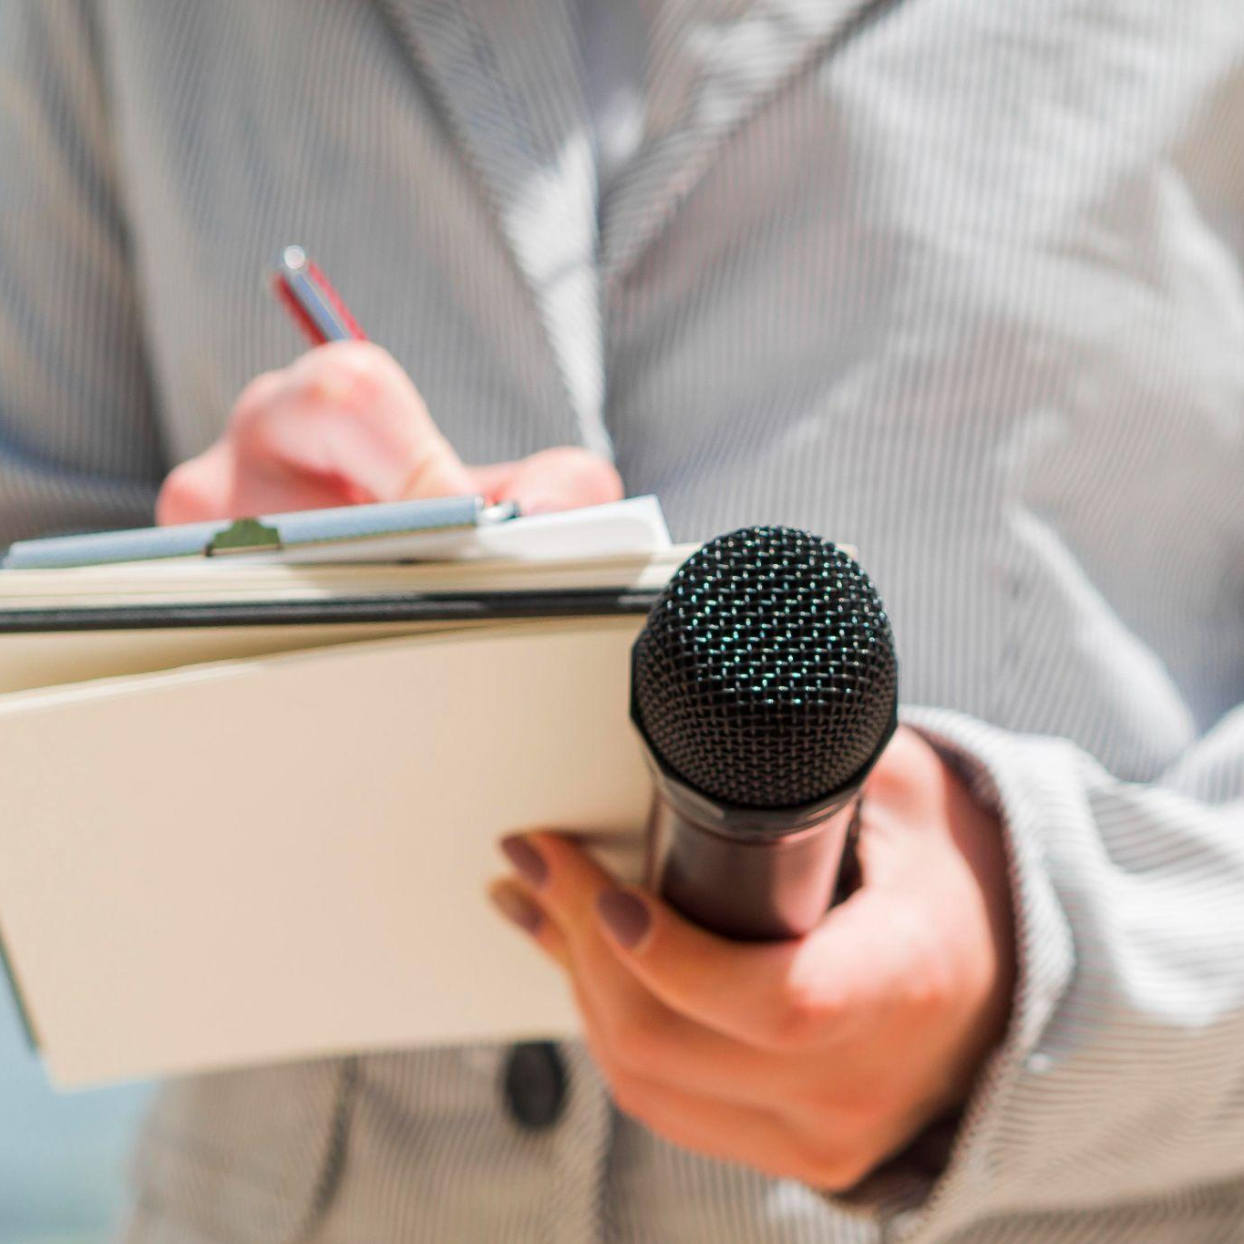
APP LOGO
Venus has a beautiful name and is the second planet from the Sun. It’s terribly hot, even hotter than Mercury, and its atmosphere is extremely poisonous:
MERCURY
VENUS
MARS
JUPITER
Insert your logo here
SATURN
NEPTUNE

Slide 22
SWOT ANALYSIS
STRENGTHS
WEAKNESSES
OPPORTUNITIES
THREATS
Venus is the second planet from the Sun
Despite being red, Mars is a cold place
Jupiter is the biggest planet of them all
Saturn is composed of hydrogen and helium

Slide 23
STRENGTHS
OPPORTUNITIES
SWOT ANALYSIS
WEAKNESSES
THREATS
Earth is the third planet from the Sun and the only one that harbors life
Venus is terribly hot, even hotter than Mercury, and its atmosphere is poisonous
Saturn is a gas giant. It's composed mostly of hydrogen and helium
Mercury is the closest planet to the Sun and the smallest of them all

Slide 24
PRODUCT OVERVIEW
USERNAME
NEWS
Mars is a very cold place
Mercury is the smallest planet
VIDEO
MENU
Jupiter is the biggest planet
Saturn is the ringed planet

Slide 25
AWESOME
WORDS

Slide 26
INVEST IN US

Slide 27
OUR PLANS
$20
You can explain your product or your service
Characteristic Characteristic
BASIC
$80
You can explain your product or your service
Characteristic Characteristic
PRO
$100
You can explain your product or your service
Characteristic Characteristic
PREMIUM

Slide 28
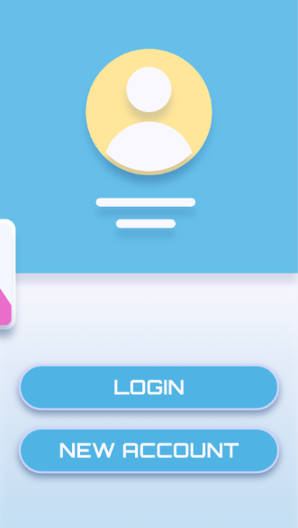
PRODUCT DEMO
Mercury is the closest planet to the Sun and the smallest one in the Solar System—it’s only a bit larger than the Moon. The planet’s name has nothing to do with the liquid metal
Insert your multimedia content here

Slide 29
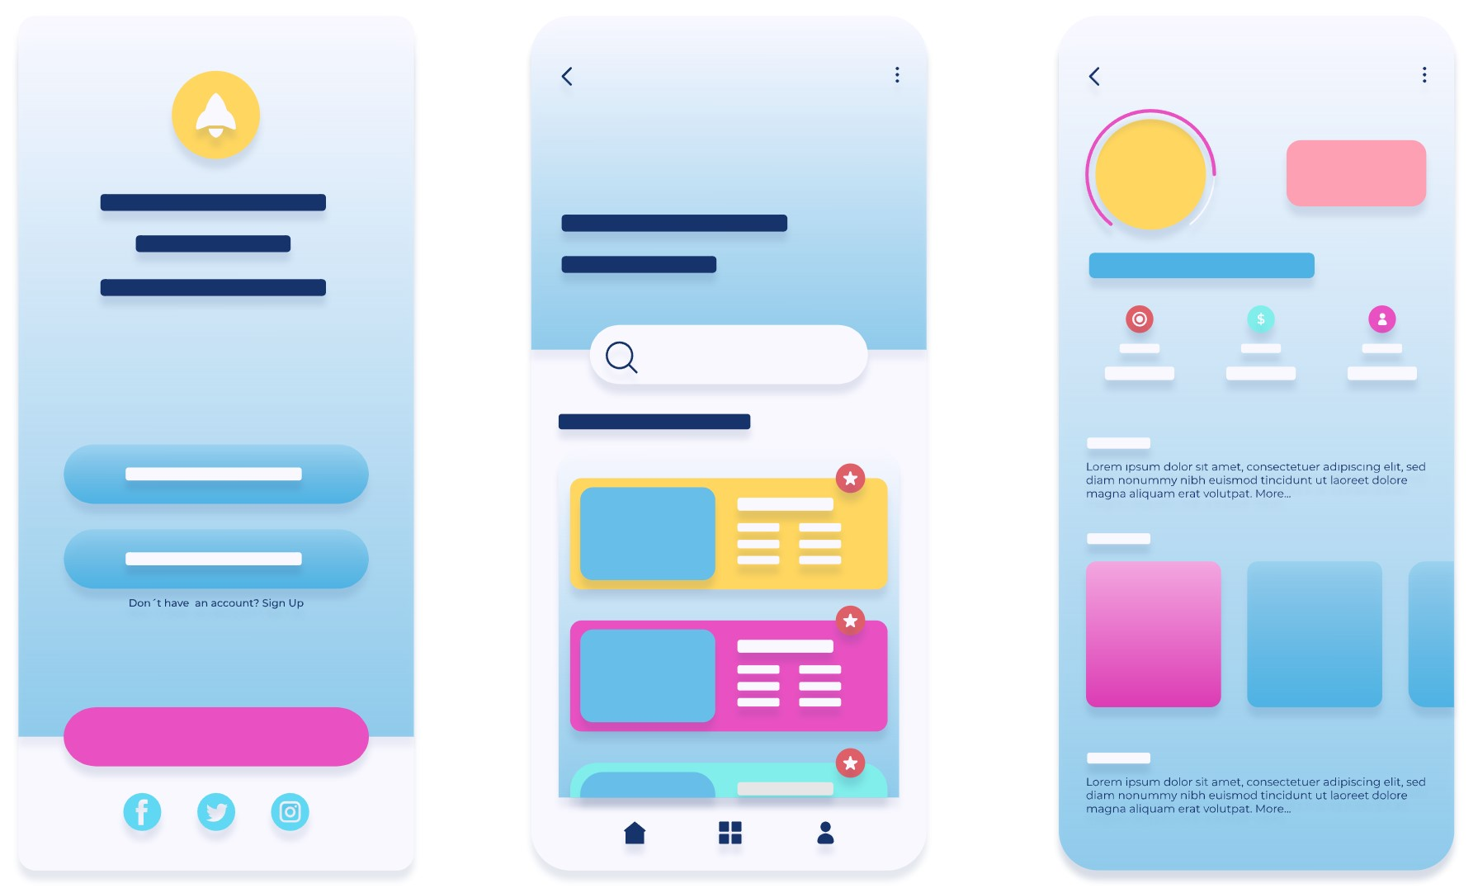
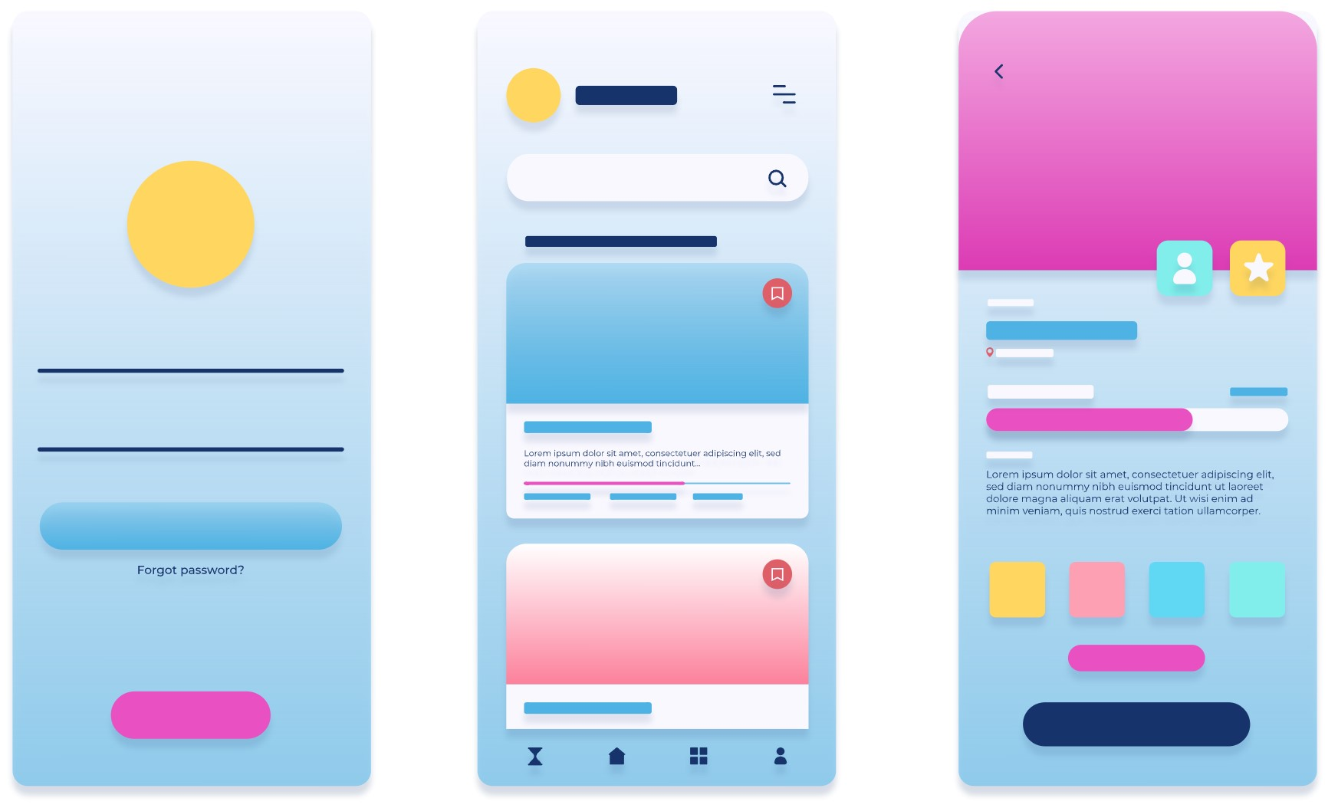
APP SCREENSHOTS
Jupiter is a gas giant and the biggest planet in our Solar System
Insert your multimedia content here

Slide 30
4,498,300
Big numbers catch your audience’s attention

Slide 31
18,620
Big numbers catch your audience’s attention

Slide 32
MARKET & COMPETITION
03
You can enter a subtitle here if you need it

Slide 33
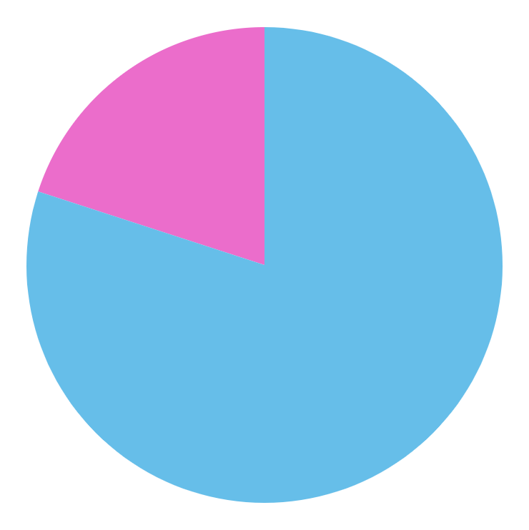
TRACTION
MARS
20%
Despite being red, Mars is actually a cold place
JUPITER
80%
Jupiter is the biggest planet in the Solar System
Follow the link in the graph to modify its data and then paste the new one here. For more info, click here

Slide 34
12,543
150,000
JUPITER
Jupiter is a gas giant and the biggest planet
MERCURY
Mercury is the closest planet to the Sun

Slide 35
DOWNLOADS IN THREE YEARS
10,588
29,637
300,703
Despite being red, Mars is a cold place
Saturn is composed of hydrogen and helium
Jupiter is a gas giant and the biggest planet

Slide 36
CASE STUDY
VENUS
MERCURY
MARS
JUPITER
SATURN
NEPTUNE
Venus is the second planet from the Sun
Mercury is the closest planet to the Sun
Despite being red, Mars is a cold place
It’s the biggest planet in the Solar System
Saturn is composed of hydrogen and helium
Neptune is the farthest planet from the Sun

Slide 37
REVIEWS
HELEN DEE
AMY McKANE
JOHN JAMES
“Saturn is a gas giant and has several rings”
“Despite being red, Mars is a cold place”
“Venus is the second planet from the Sun”

Slide 38
AWARDS
 | SATURN | JUPITER | MARS | VENUS
2015
2016
2021

Slide 39
MAP OF PRINCIPAL MARKETS
40%
20%
MERCURY
SATURN
Mercury is the smallest planet
Saturn is the ringed planet

Slide 40
PRINCIPAL MEDIA PERCENTAGES
80%
55%
MERCURY
VENUS
It’s the closest planet to the Sun and the smallest one in the Solar System
It’s terribly hot, even hotter than Mercury, and is extremely poisonous

Slide 41
MARKET SIZE
20%
40%
80%
Venus
Mars
Mercury

Slide 42
OUR INVESTORS
MARS
MERCURY
VENUS
Despite being red, Mars is a cold place. It’s full of iron oxide dust
Mercury is the closest planet to the Sun and the smallest one
It has a beautiful name and is the second planet from the Sun

Slide 43
MARKET GROWTH
30%
Venus
50%
Saturn
80%
Neptune

Slide 44
TARGET
GENDER
AGE
45%
25-
43%
55%
26+
57%
INTERESTS
Mars is a very cold place
Venus has a beautiful name
Mercury is the smallest planet

Slide 45
TARGET
20-35
80%
GENDER
36-50
20%
80%
FEMALE
Average spend per customer
$50.00
MALE
20%
Traveling
Writing

Slide 46
CALENDAR
MERCURY
SUN | MON | TUE | WED | THU | FRI | SAT
30 | 31 | 01 | 02 | 03 | 04 | 05
06 | 05 | 08 | 09 | 10 | 11 | 12
13 | 14 | 15 | 16 | 17 | 18 | 19
20 | 21 | 22 | 23 | 24 | 25 | 26
27 | 28 | 29 | 30 | 01 | 02 | 03
8:00 am - 16:00 pm
VENUS
14:00 pm - 17:00 pm
JUPITER
5:00 am - 11:00 am
SATURN
18:00 pm - 23:00 pm

Slide 47
COMPETITORS
NEPTUNE
MERCURY
MARS
VENUS
Neptune is the farthest planet from the Sun
Mercury is the closest planet to the Sun
Mars is a cold place full of iron oxide dust
Venus is the second planet from the Sun

Slide 48
CHARACTERISTICS
MERCURY
VENUS
MARS
JUPITER
PLUTO
NEPTUNE
It’s the closest planet to the Sun
Venus is the second planet from the Sun
Mars is actually a very cold place
Jupiter is the biggest planet
It’s now considered a dwarf planet
It’s the farthest planet from the Sun

Slide 49
WHY SHOULD YOU USE OUR APP?
EARTH
MERCURY
SATURN
It’s the third planet from the Sun and where we live on
It’s the closest planet to the Sun and the smallest one
It’s a gas giant and has several rings

Slide 50
BUSINESS PILLARS
Venus is terribly hot, even hotter than Mercury, and its atmosphere is poisonous
Mercury is the closest planet to the Sun and the smallest of them all
Saturn, the ringed planet, is composed mostly of hydrogen and helium

Slide 51
OUR GOALS
SATURN
VENUS
MARS
Despite being red, Mars is a cold place. The planet is full of iron oxide dust
Venus has a beautiful name and is the second planet from the Sun. It’s terribly hot
Mercury is the closest planet to the Sun and the smallest one in the Solar System

Slide 52
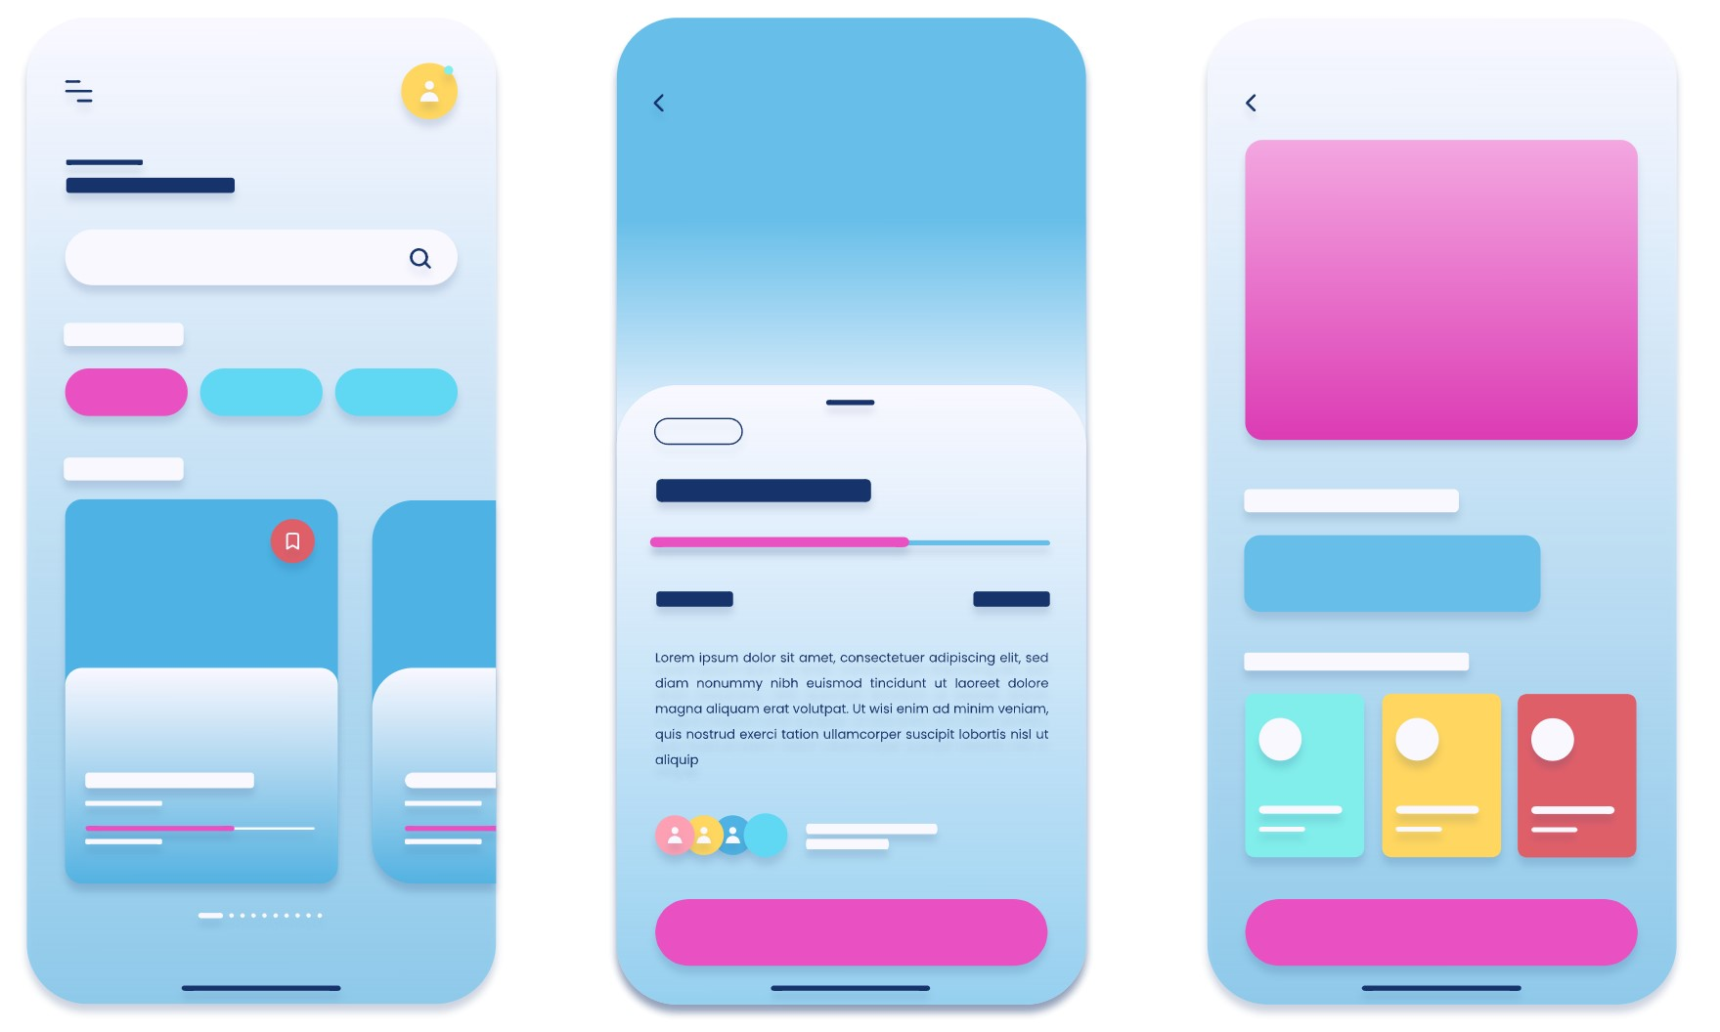
PRODUCT DEMO
01
Jupiter is the biggest planet of them all
02
Despite being red, Mars is a cold place
Insert your multimedia content here
Insert your multimedia content here

Slide 53
PRODUCT DEMO
04
Saturn is a gas giant and has rings
03
Venus is the second planet from the Sun
Insert your multimedia content here
Insert your multimedia content here

Slide 54
SCREEN DESCRIPTION
MERCURY
It’s the smallest planet in the Solar System
Insert your multimedia content here
VENUS
It’s the second planet from the Sun
SATURN
It's composed mostly of hydrogen and helium

Slide 55
BUSINESS MODEL
MARKETING
ASSESSMENT
Neptune is very far away from Earth
Despite being red, Mars is a cold place
TRAINING
TECHNOLOGY
Saturn is a gas giant and has rings
Mercury is the closest planet to the Sun

Slide 56
TIMELINE
JUPITER
MARS
It’s the biggest planet of them all
Despite being red, Mars is a cold place
2019
2020
2021
2022
SATURN
MERCURY
Saturn is a gas giant and has rings
It’s the closest planet to the Sun

Slide 57
TIMELINE
Jupiter is a gas giant and the biggest planet
Mercury is the closest planet to the Sun
Venus is the second planet from the Sun and is terribly hot
DAY 1
DAY 2
DAY 3

Slide 58
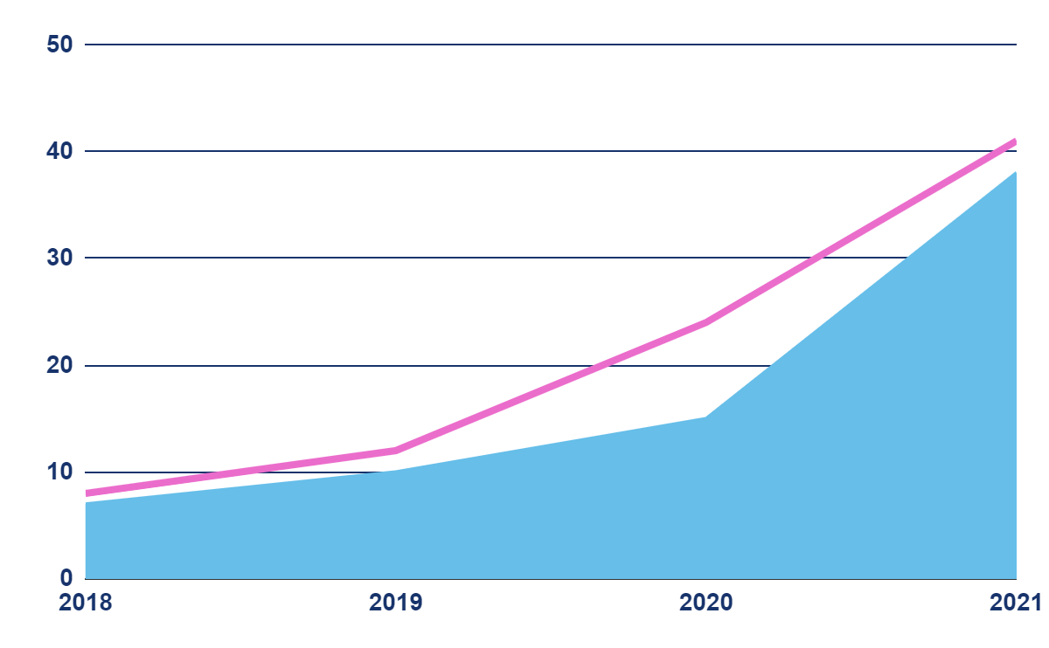
PREDICTED GROWTH
+41%
Expected income for 2021
+38%
New employees next year
Follow the link in the graph to modify its data and then paste the new one here. For more info, click here

Slide 59
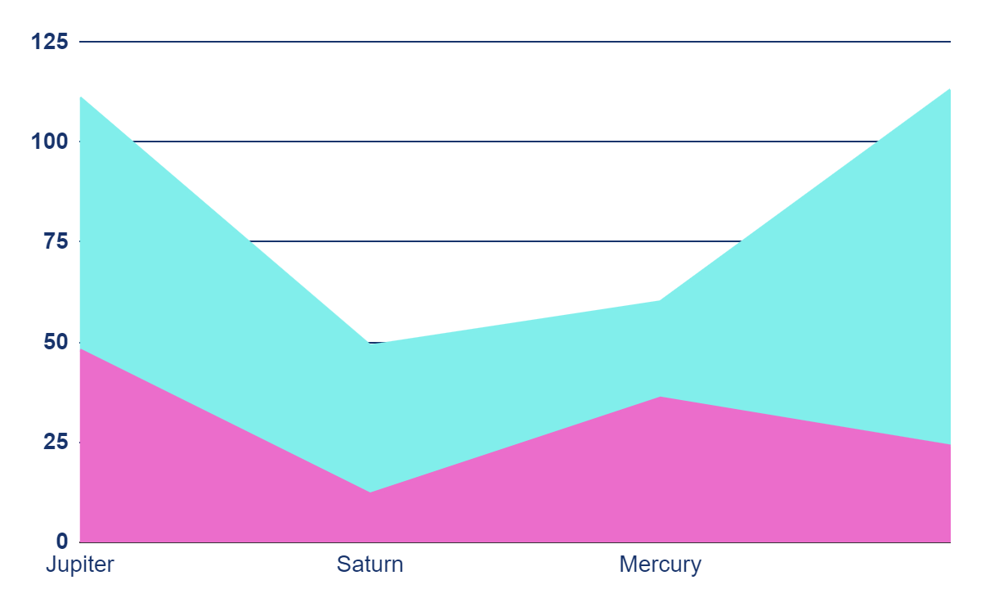
INVESTMENT
NEPTUNE
SATURN
Neptune is far away from us
Saturn is the ringed planet
MERCURY
JUPITER
Mercury is the smallest planet
Jupiter is the biggest planet
Follow the link in the graph to modify its data and then paste the new one here. For more info, click here

Slide 60
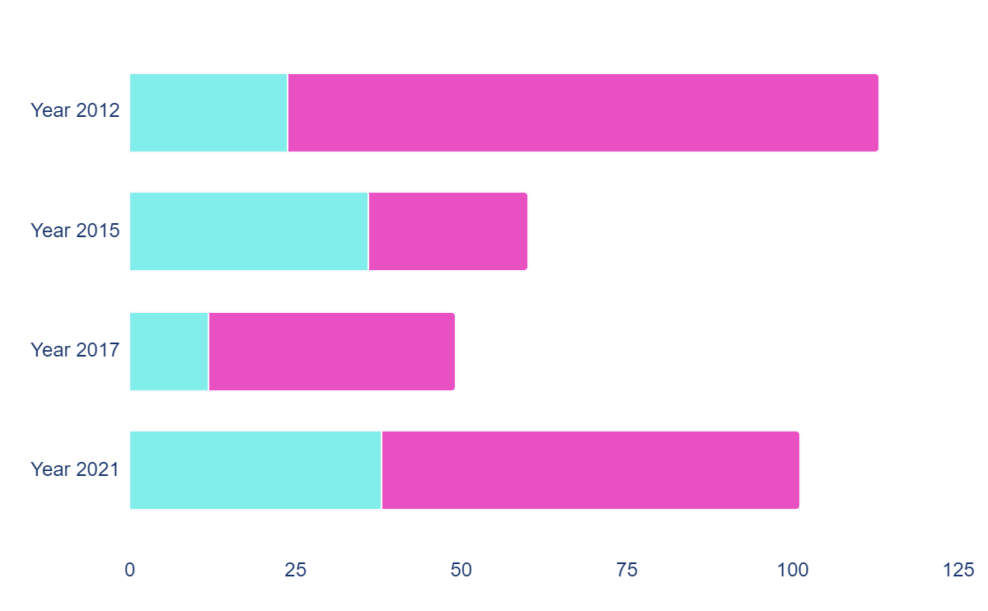
INVESTMENT
MERCURY
It’s the closest planet to the Sun
JUPITER
It’s the biggest planet of them all
Follow the link in the graph to modify its data and then paste the new one here. For more info, click here

Slide 61
THANKS!
Do you have any questions?
youremail@freepik.com
+91 620 421 838
yourwebsite.com
Please keep this slide for attribution

